Slide 1
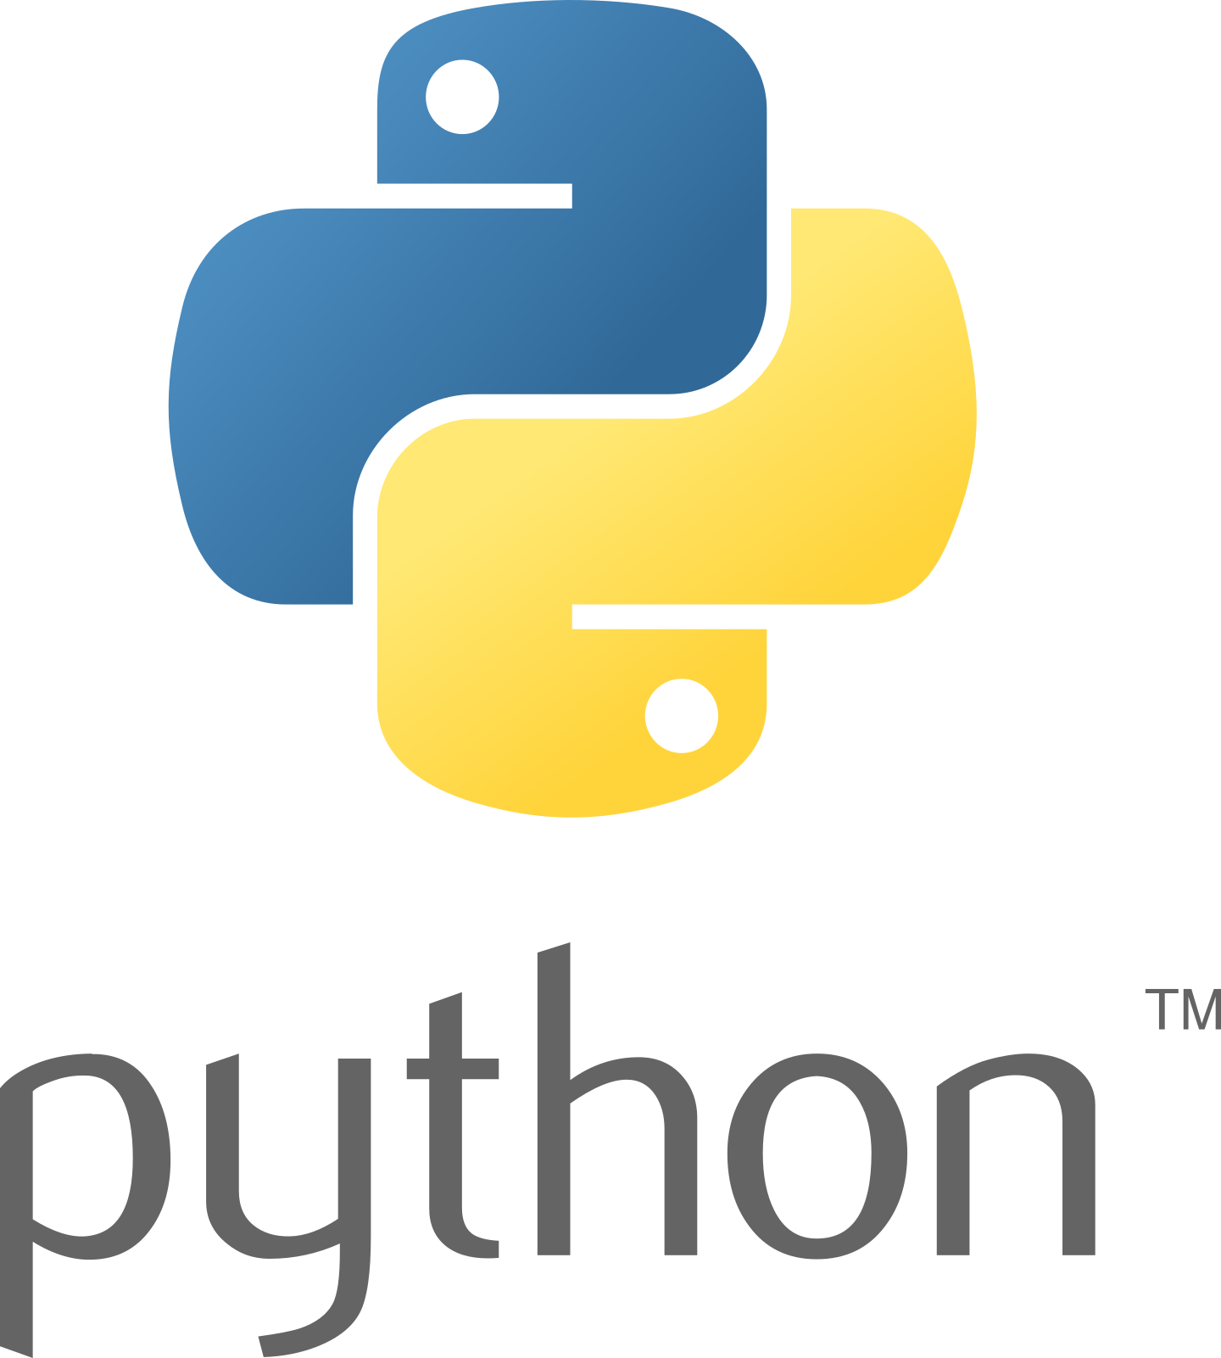

PYTHON PROGRAMMING
Welcome to the “Ultimate Python Programming ," your comprehensive guide to mastering Python programming. This handbook is designed for beginners and anyone looking to strengthen their foundational knowledge of Python, a versatile and user-friendly programming language.

Slide 2
TODAY TOPICS
PURPOSE AND AUDIENCE
STRUCTURE AND CONTENT
WHY PYTHON?
ACKNOWLEDGEMENTS
WHAT IS PROGRAMMING?
WHAT IS PYTHON?
FEATURES OF PYTHON
INSTALLATION
CONCLUSION

Slide 3
PURPOSE AND AUDIENCE
This make programming accessible and enjoyable for everyone. Whether you're a student new to coding, a professional seeking to enhance your skills, or an enthusiast exploring Python, this handbook will definitely be helpful. Python's simplicity and readability make it an ideal starting point for anyone interested in programming.

Slide 4
STRUCTURE AND CONTENT
The handbook is divided into clear, concise chapters, each focused on a specific aspect of Python:
• Fundamental Concepts: Start with the basics, such as installing Python and writing your first program.
• Practical Examples: Illustrative examples and sample code demonstrate the application of concepts.
• Hands-On Exercises: End-of-chapter exercises reinforce learning and build confidence.
• Additional Resources: References to official Python documentation for deeper exploration.

Slide 5
WHY PYTHON?
Python is known for its simplicity and readability, making it perfect for beginners. It is a high-level, interpreted language with a broad range of libraries and frameworks, supporting applications in web development, data analysis, AI, and more. Python's versatility and ease of use make it a valuable tool for both novice and experienced programmers.

Slide 6
ACKNOWLEDGEMENTS
I extend my gratitude to the educators, programmers, and contributors who have shared their knowledge and insights, shaping the content of this handbook. Special thanks to all the students watching my content on YouTube and Python community for maintaining a supportive and inspiring environment for learners worldwide.

Slide 7
WHAT IS PROGRAMMING?
Just like we use Hindi or English to communicate with each other, we use a programming language like Python to communicate with the computer. Programming is a way to instruct the computer to perform various tasks.

Slide 8

WHAT IS PYTHON?
Python is a simple and easy to understand language which feels like reading simple English. This Pseudo code nature is easy to learn and understandable by beginners.

Slide 9
FEATURES OF PYTHON
• Easy to understand = Less development time
• Free and open source
• High level language
• Portable: Works on Linux / Windows / Mac.
• Fun to work with!

Slide 10
INSTALLATION
Python can be easily installed from python.org. When you click on the download button, python can be installed right after you complete the setup by executing the file for your platform.
And VS CODE

Slide 11
CONCLUSION
Learning programming can be both exciting and challenging. The “Ultimate Python Programming Handbook" aims to make your journey smooth and rewarding. Watch my video along with following this handbook for optimal learning. Let this guide be your stepping stone to success in the world of programming.

